Slide 1
Digital Grammar and Dictionary of Àbèsàbèsì
Jonas Lau

Slide 2
Overview
Three projects
  Documenting Àbèsàbèsì
  Digital Grammar of Àbèsàbèsì
  Digital Dictionary of Àbèsàbèsì

Slide 3
Overview
Three projects
  Documenting Àbèsàbèsì
  Digital Grammar of Àbèsàbèsì
  Digital Dictionary of Àbèsàbèsì

Slide 4
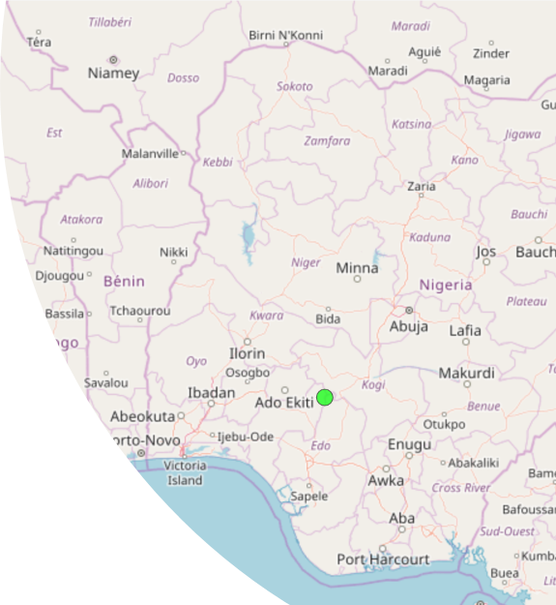
Àbèsàbèsì
Exonym: Akpes
9 settlements (4 dialects)
Speakers: 10.000???

Slide 5
Àbèsàbèsì Data
Fieldwork
  January to March
  August to October
Elicited data (wordlists)
Lexemes extracted from recordings
Tool: Fieldwork Language Explorer

Slide 6
Digital Grammar of Àbèsàbèsì
Goals:
  Propose a digital data format for reference grammars
  Focus on language documentation
  Use Àbèsàbèsì as a case study

Slide 7
Digital Grammar of Àbèsàbèsì
Components
  Data format
  Web application

Slide 8
Digital Grammar of Àbèsàbèsì
Data format
  TEI based
Web application
  existDB
  Mainly using XQuery

Slide 9
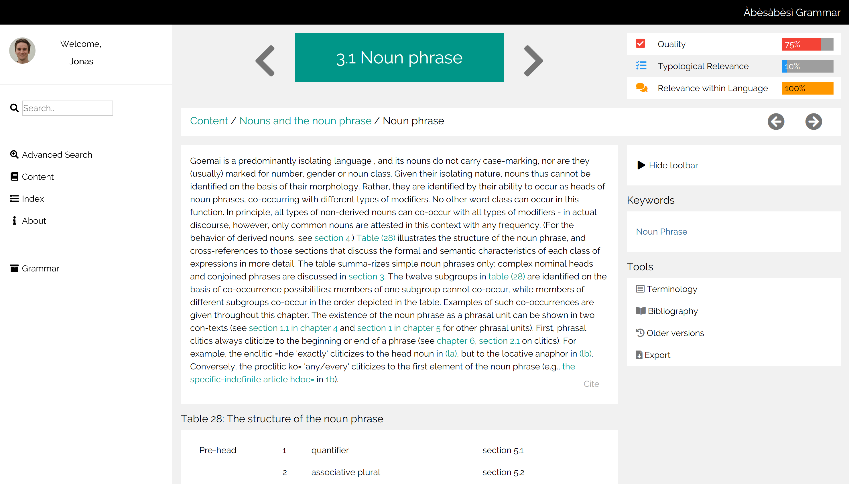
Web Application

Slide 10
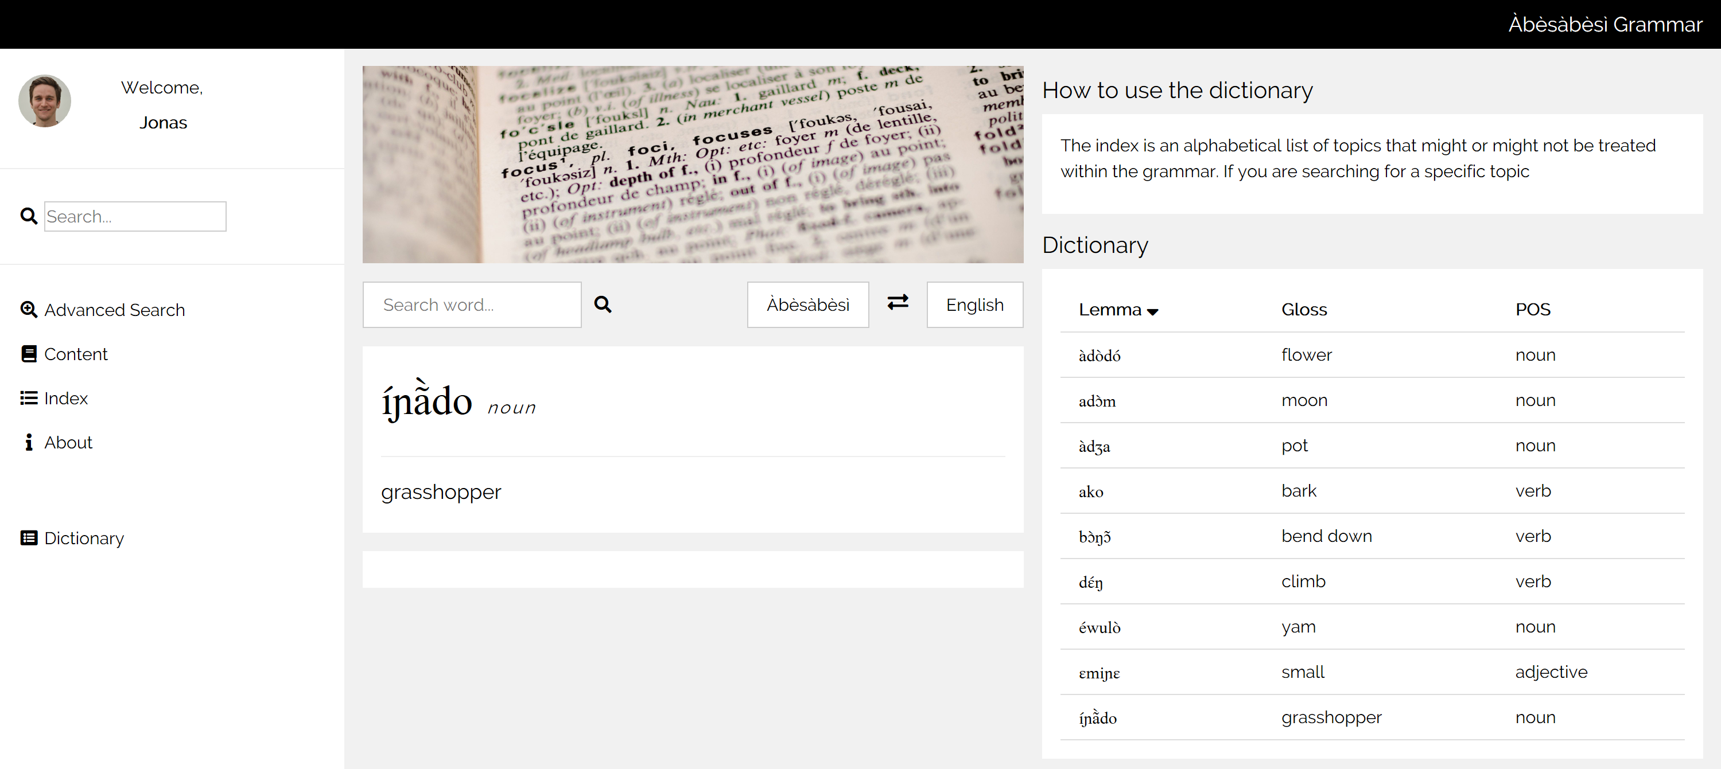
Dictionary of Àbèsàbèsì

Slide 11
Dictionary of Àbèsàbèsì

Slide 12
Tasks
Transform LIFT to TEI (through XSLT)
Read and display data
Sorting functionalities

Slide 13
Objectives for LexMC18
Best practices
Structure lexical data using TEI
Learn to integrate XSLT
Inspiration

Slide 14
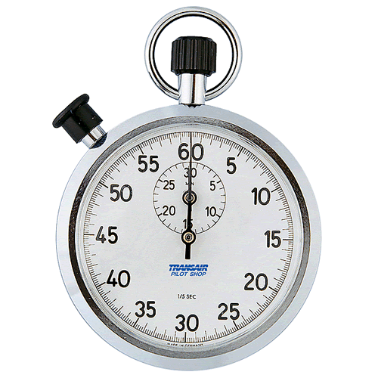
Time’s Up!
About your speaker:
  Name: Jonas Lau
  Institution:
    Institut für Sprachwissenschaft,
    Universität zu Köln
  Quick bio:
    BA Empirical Linguistics (Frankfurt am Main)
    MA Language Documentation and Description (SOAS, University of London)
    Work: Endangered Languages Archive,
    Kauz Linguistic Technologies

